Slide 1

Reading and writing for your dissertation

Slide 2
What we will cover today
Strategic literature searches to support range
Navigating journal articles
Structure & function of literature reviews
Guidance for writing your dissertation report
How does reading help me write?
Using sources in your text
Kizzy Beaumont - k.beaumont@keele.ac.uk
For more info on Student Learning workshops head to - https://www.keele.ac.uk/studentlearning/how2workshops/

Slide 3
1.Review of academic reading

Slide 4

Range?
For more info on Student Learning workshops head to - https://www.keele.ac.uk/studentlearning/how2workshops/

Slide 5
Research Question
Sub-topic/ question
Sub-topic/ question
Central focus
Sub-topic/ question
Sub-topic/ question
How will I explore? Who and/or what will I draw on?
Background
Key terms
Key players
Synonyms
Additional sources
For more info on Student Learning workshops head to - https://www.keele.ac.uk/studentlearning/how2workshops/

Slide 6
Consider the question matrix
Topic 1... | Topic 2... | Topic 3... | Topic 4... | Topic 5... | Topic 6...
Topic 1... | Topic 2... | Topic 3... | Topic 4... | Topic 5... | Topic 6...
What does this mean?
Who first developed it?
Why was it developed?
What positive impacts did it have?
What were the issues?
How were the issues resolved?
How was it tested?

Slide 7
2.Reading & writing for a literature review

Slide 8
Literature Reviews = Critical Analysis
A critical analysis is subjective writing because it expresses the writer's opinion or evaluation of something, supported by evidence. Writing a critical assignment requires two steps: critical reading and critical writing.
For more info on Student Learning workshops head to - https://www.keele.ac.uk/studentlearning/how2workshops/

Slide 9
What is critical thinking?
‘Critical’ has + & - meanings.
Does not mean just criticise.
Weigh up the arguments for and against.
Look deeper into what is being said and WHY.
Question what you read.
Identify strengths and weaknesses.
Evaluate what is being argued.
Do YOU agree with it?
Level 6 - Demonstrates wider knowledge and deeper understanding of subject.
For more info on Student Learning workshops head to - https://www.keele.ac.uk/studentlearning/how2workshops/

Slide 10
How to Think Critically
Form a set of questions to help you think more deeply about what you have read.
Use your answers to develop your academic argument.
Apply these questions and similar ones to all of your...
arguments
assignments
life experiences
...to encourage you to question why things are the way they are.
For more info on Student Learning workshops head to - https://www.keele.ac.uk/studentlearning/how2workshops/

Slide 11
Critical Analysis: Tools
CRAAP Checklist (Currency Relevance Accuracy Authority Purpose)
CASP (Critical Appraisal Skills Programme) Checklists
Cornell University Critical Appraisal Guidance
Manchester Uni My Learning Essentials & Academic Phrasebank
For more info on Student Learning workshops head to - https://www.keele.ac.uk/studentlearning/how2workshops/

Slide 12
Critical Analysis of Literature
What questions do you bring to your reading?
How old is the source?
What country was it written in?
If it is data-based, what is the sample size?
Research method?
How does it link to other publications?
What are the limitations/flaws in the argument?
Who supports this position?
How it is relevant to my essay?
Do I agree??
For more info on Student Learning workshops head to - https://www.keele.ac.uk/studentlearning/how2workshops/

Slide 13
Analysis + evaluation = Synthesis
Combining ideas to make a new whole

Slide 14
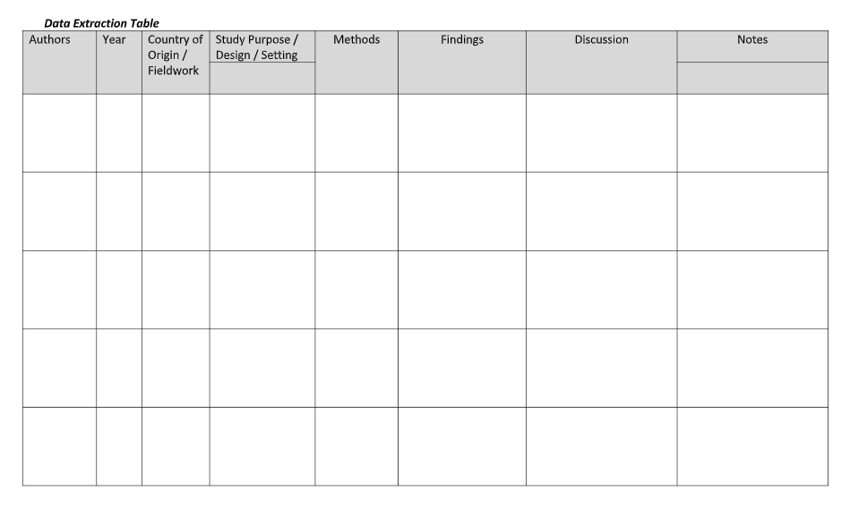
Information synthesis
See the KLE for these and other resources

Slide 15
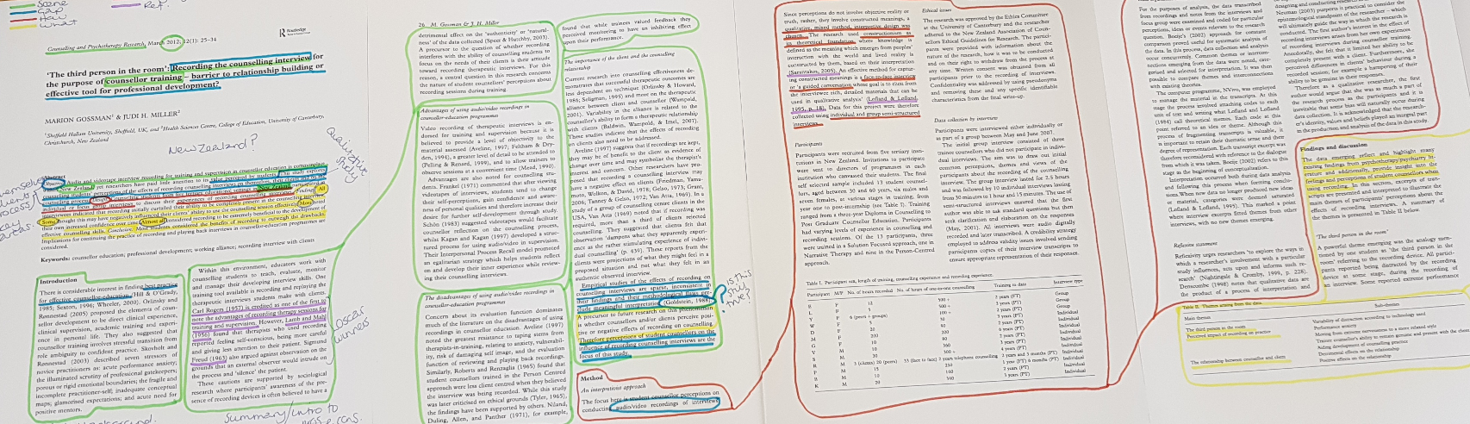
How do we critically analysis a scientific article?
Start with - text mapping & the A-C method
For more info on Student Learning workshops head to - https://www.keele.ac.uk/studentlearning/how2workshops/

Slide 16
3.Building reading into your writing

Slide 17
Reading to explore the question…
Range
Wider your knowledge base
Further critical analysis
Easier it will be to write
For more info on Student Learning workshops head to - https://www.keele.ac.uk/studentlearning/how2workshops/

Slide 18
Before you write you need to have read!

Slide 19
Who?
Why?
How?
What?
Topic
Why Not?
When?
What else?
So what?
What if?
What next?
For more info on Student Learning workshops head to - https://www.keele.ac.uk/studentlearning/how2workshops/

Slide 20
What if your reading & research has generated lots of ideas?
Buy-out sentences!

Slide 21
Buy-out sentences
Set the tone! Show selectivity and critical appraisal of topic
Get out ‘in front’ of your markers
Contain your argument - easier to write
E.g. “Any discussion of small group teaching could focus on intergroup dynamics or the role of the facilitator. This discussion, however, will focus on the role of clear task instructions and class pacing. These have been highlighted as areas of significant importance by Beard and Wilson (2005) and will be explored in depth”.

Slide 22
Can the literature dictate the structure?
Evidence that sits here - useful but limited in relevance or credibility - should be used as back-up evidence
Evidence that sits here should be used as main evidence to reinforce your argument
Usefulness
Relevance/ Credibility

Slide 23
What is the point of referencing?

Slide 24

What is the point of referencing?
“essential skill for higher education” (Neville, 2009, p. 95)
Substantiates the evidence on which discussion or argument is based.
Gives credibility to the information presented.
Enables sources to be traced and authenticated.
Used to connect and synthesise ideas.

Slide 25

How do we use our reading in our writing?
Direct vs Indirect Citation?

Slide 26
Direct vs Indirect
Direct:
Indirect:
As Baiasu (2016) points out, blah blah blah blah, which supports D’Oro’s (2012) position that blah blah blah blah.
Blah blah blah blah blah blah blah blah blah blah (Baiasu, 2016; D’Oro’s, 2012) blah blah blah blah blah blah blah blah.
References
Baiasu, S. (2016) Is Kant’s Metaphysics Profoundly Unsatisfactory? Critical Discussion of A. W. Moore’s Critique of Kant. Kantian Review, vol. 21(3), 465-481
D’Oro, G. (2012) Reasons and causes: the philosophical battle and the meta-philosophical war. Australasian journal of philosophy, vol. 90(2), 207-221

Slide 27
Reporting Verbs and Connectors
What’s the difference here?:
Brown (1983) claims that a far more effective approach is ...
Brown (1983) points out that a far more effective approach is ...
A far more effective approach is ... (Brown, 1983)
What’s the writer’s ‘job’ here?:
In contrast to Smith, Jones (2013) argues that …
A broader perspective has been adopted by Smith (2013) who argues that …
Conversely, Wang (2010) reported no significant difference in mortality between X and Y.
Warwick University - Reporting verbs
(Academic Phrasebank, Online)

Slide 28


Thanks!
Any questions?
Academic Reading Retreat:
Wednesday 23rd October 2019, 9:00 till 16:30
Writing Retreat:
Wednesday 20th November 2019 13:00 till 17:00
For more info on Student Learning workshops head to - https://www.keele.ac.uk/studentlearning/how2workshops/

Slide 29

All feedback welcome
Go to - https://tinyurl.com/NatSciFeedback
Place your screenshot here

